Slide 1
Deterministic Finite Automaton and Non-deterministic Finite Automaton
DFA and NFA
(Finite State Machines)

Slide 2
Notation and Definitions
Alphabet
String
Language
Operations on languages

Slide 3
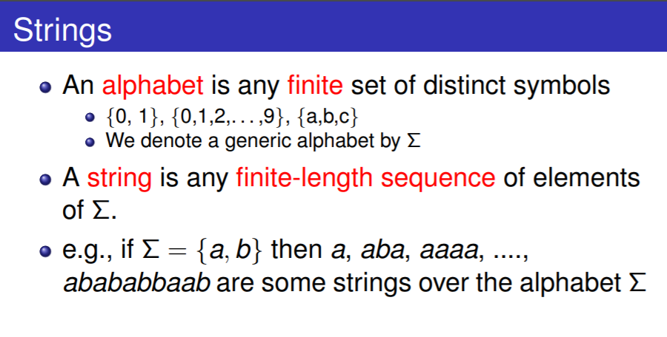

Slide 4
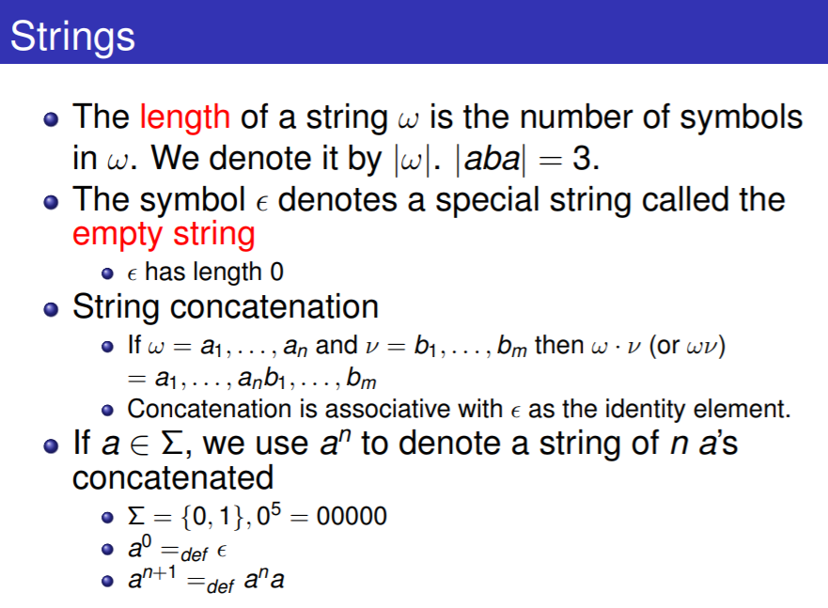

Slide 5
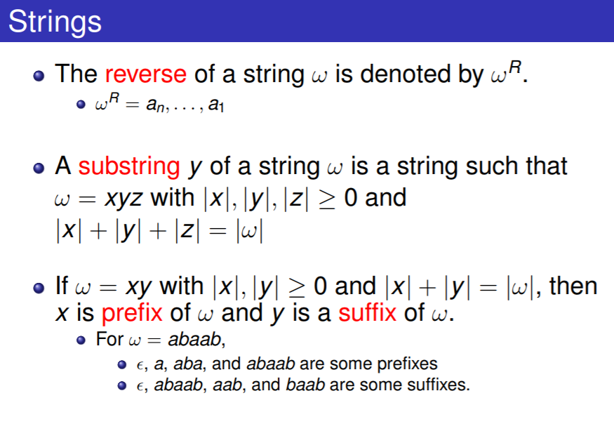

Slide 6
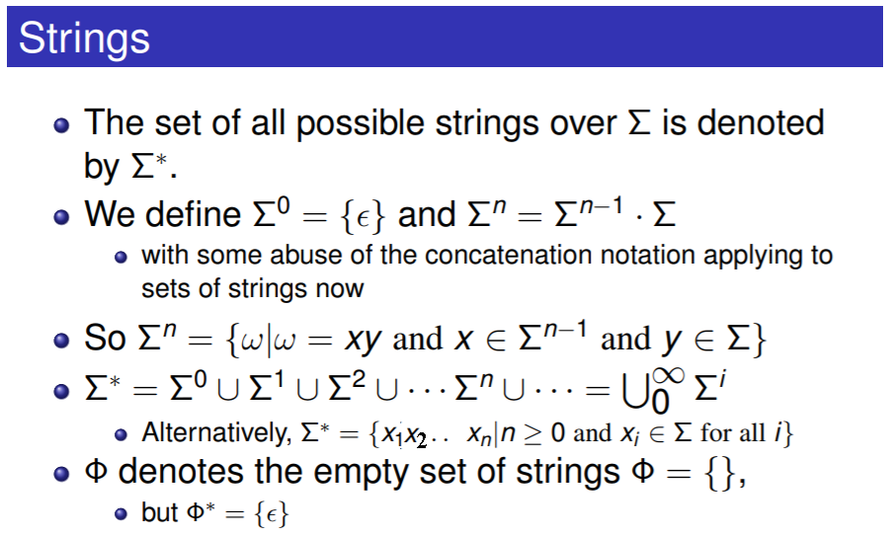

Slide 7
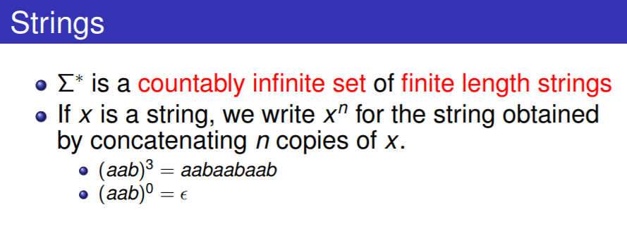

Slide 8
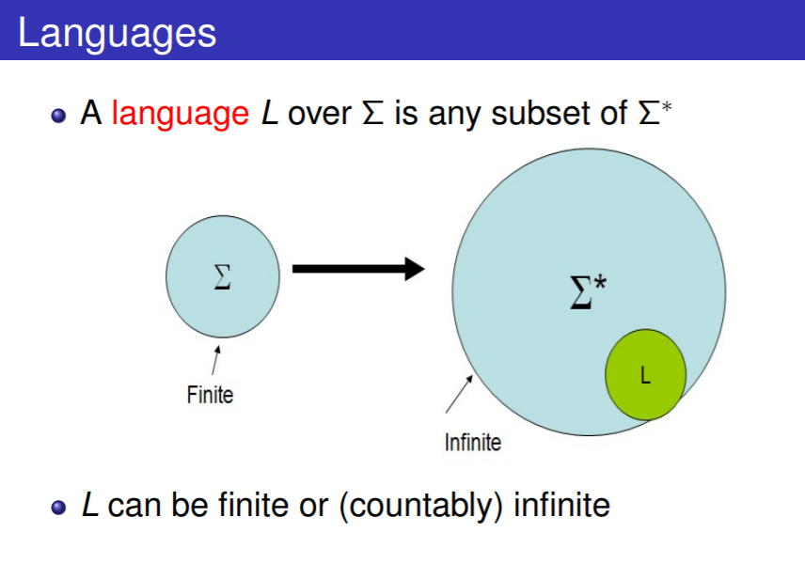

Slide 9
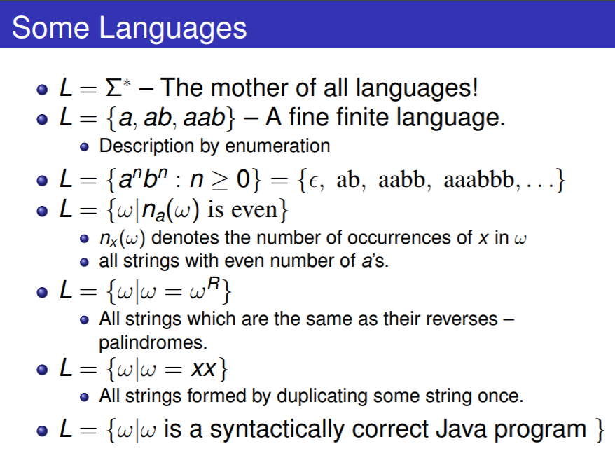

Slide 10
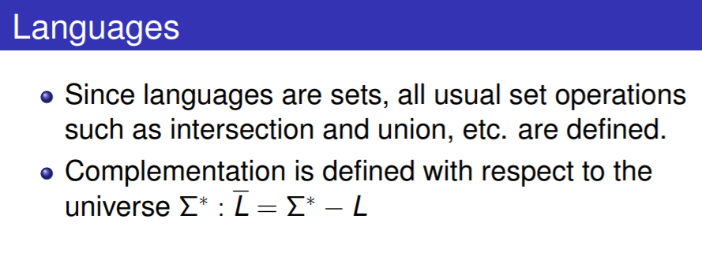

Slide 11
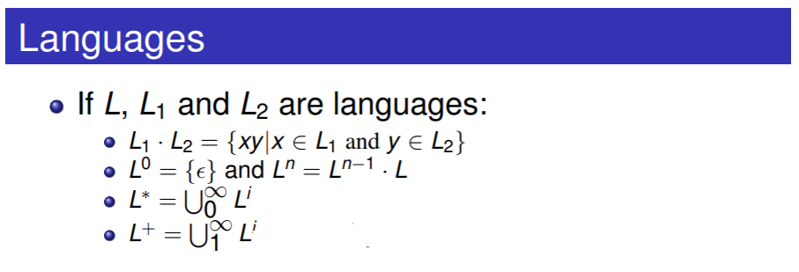

Slide 12
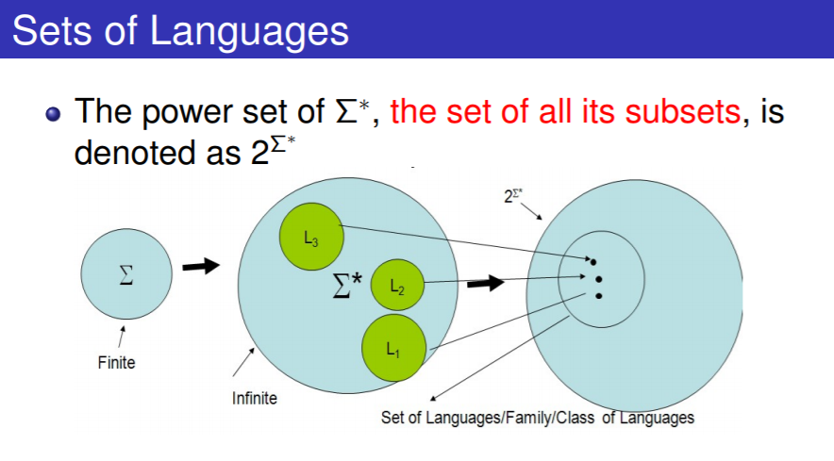

Slide 13
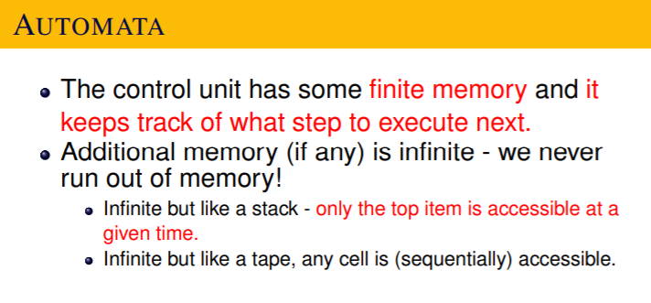

Slide 14
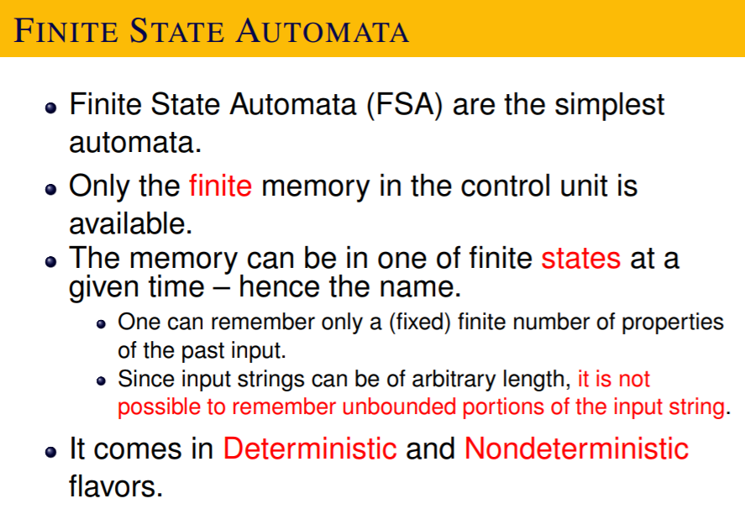

Slide 15
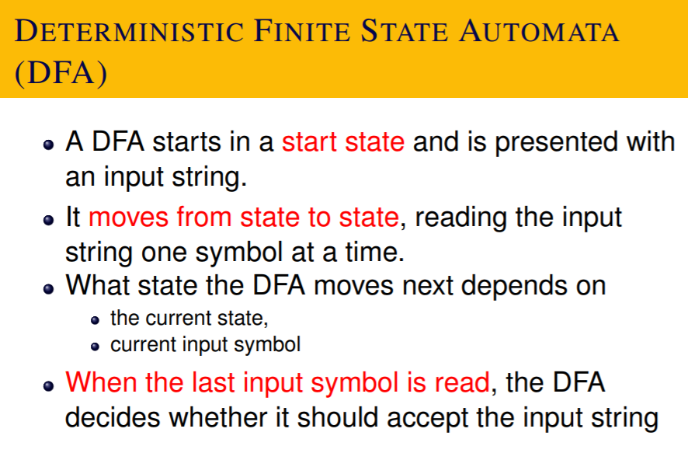

Slide 16
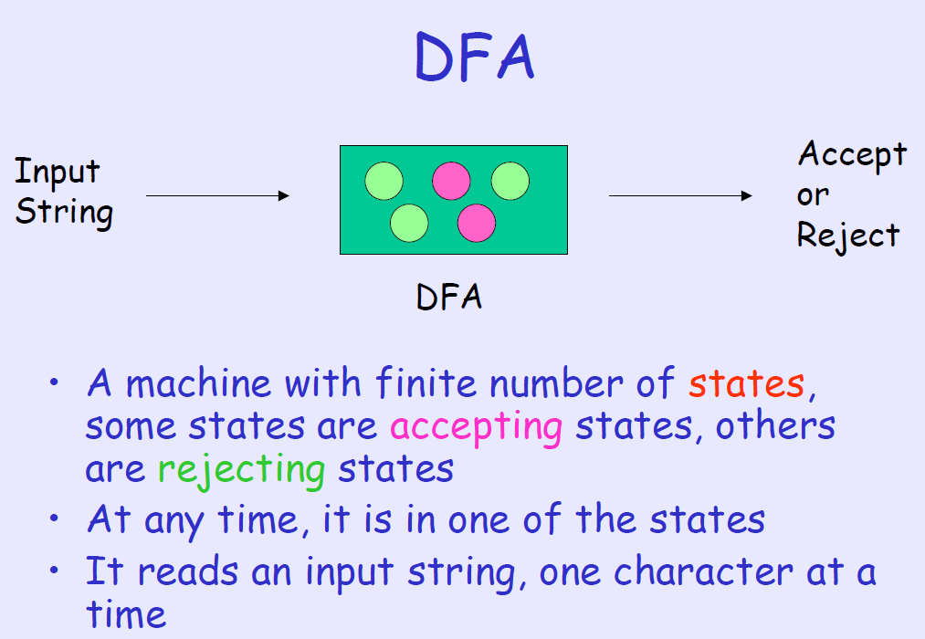
Finite State Machines

Slide 17
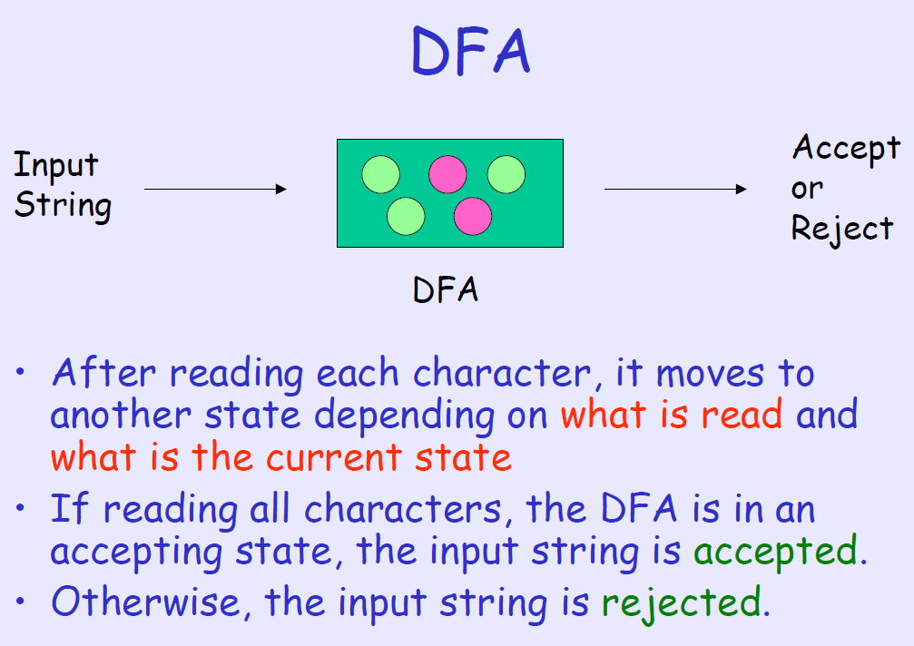

Slide 18
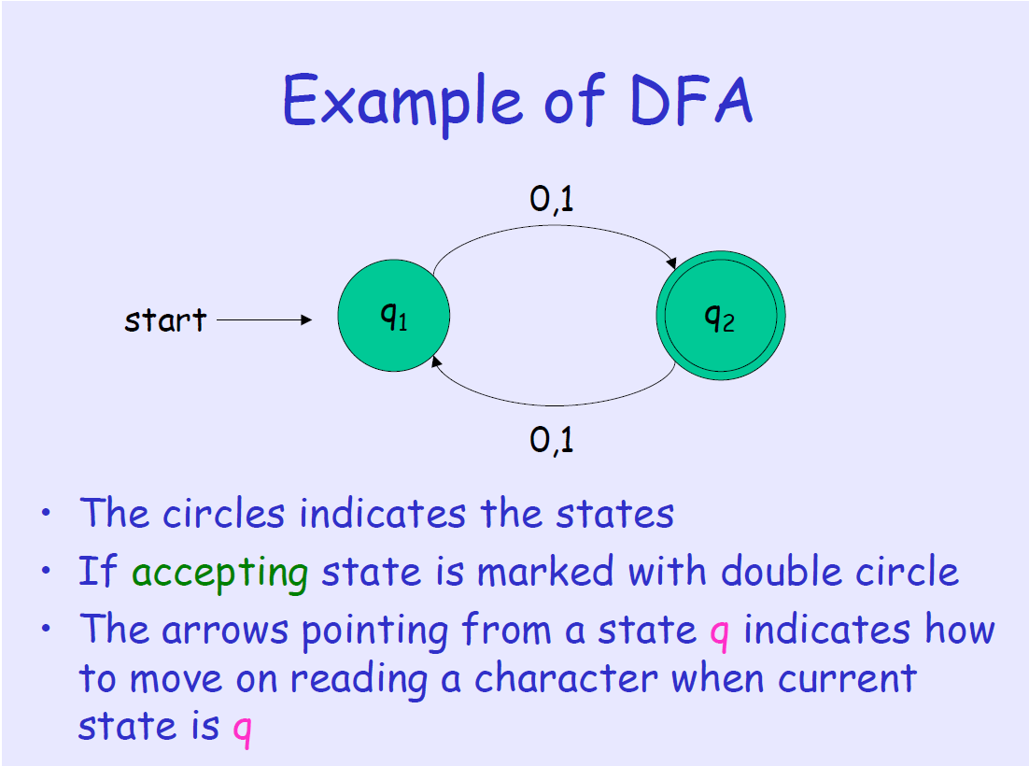

Slide 19
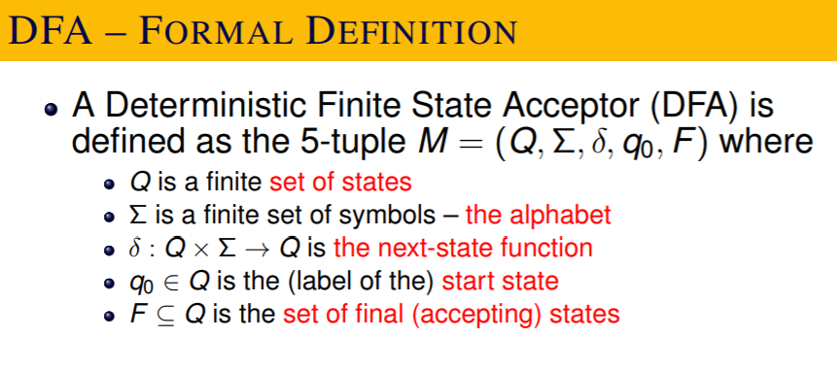

Slide 20
Note, there must be exactly one start state.
Final states can be many or even empty !

Slide 21
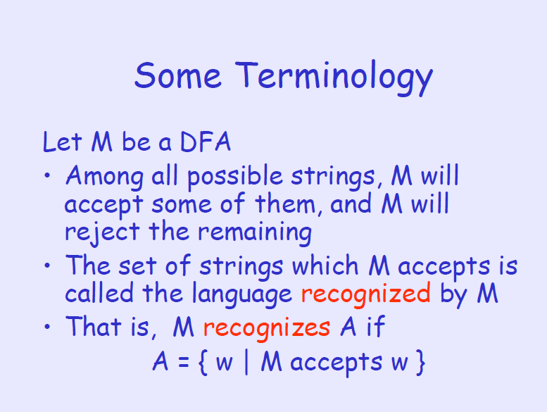

Slide 22
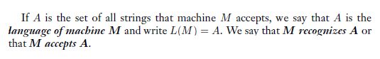
L(M)

Slide 23
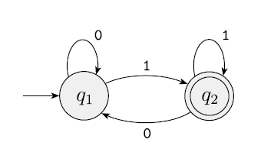

Slide 24
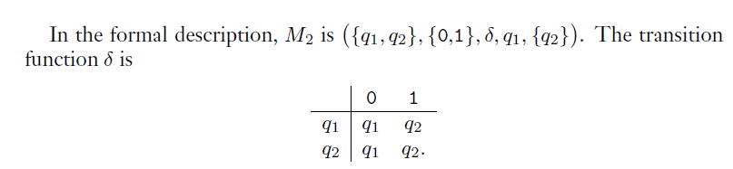

Slide 25
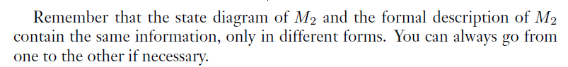

Slide 26
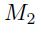
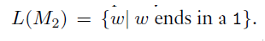

Slide 27
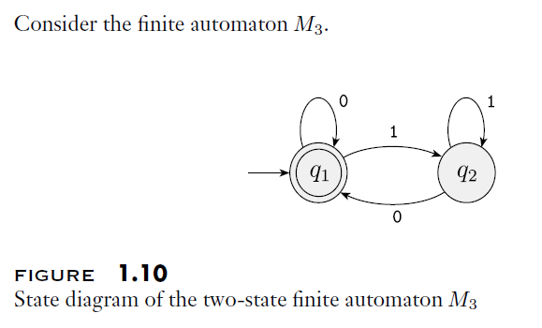
Can you describe this in the 5 tuple form?
In particular, can you write down the transition table?

Slide 29
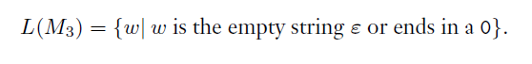

Slide 30
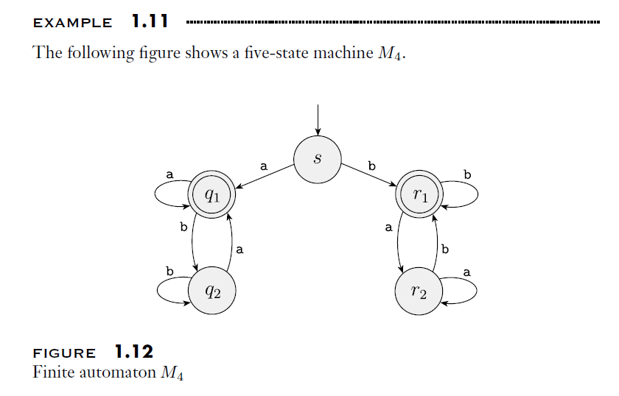

Slide 32
DFA for complement of a language
Flip final and non-final states.

Slide 33
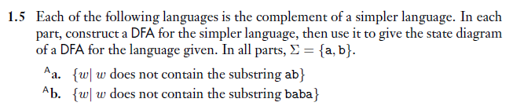

Slide 34
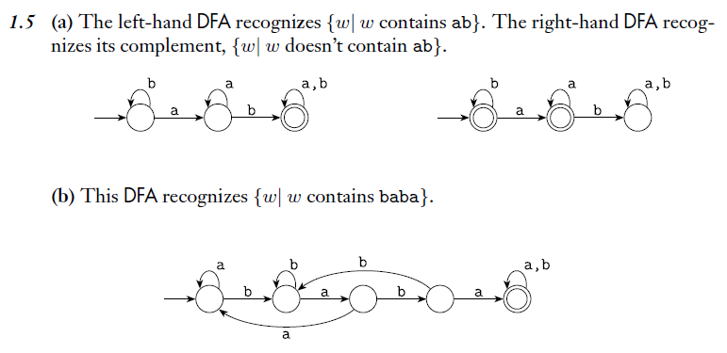
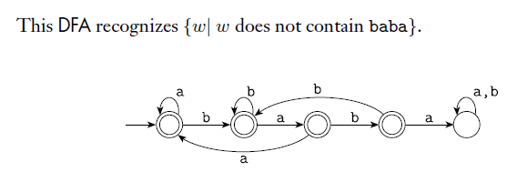

Slide 35
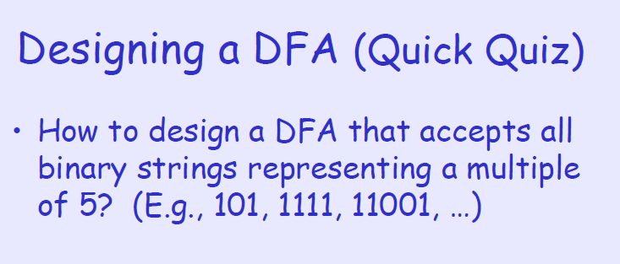

Slide 36
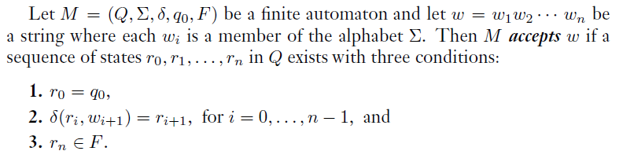
Formally

Slide 37
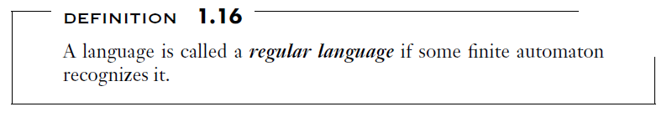
Regular language [Ref: Sipser Book]

Slide 38
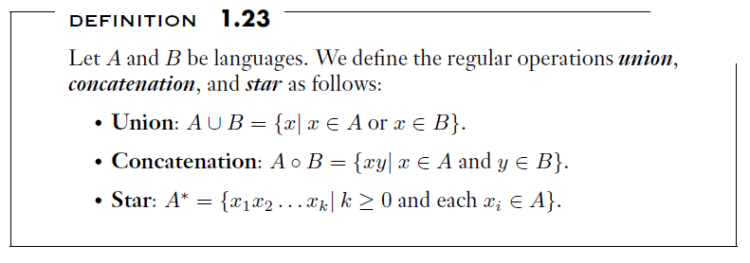
The regular operations
These are similar to arithmetic operations.
Note, * is a unary operator.

Slide 39
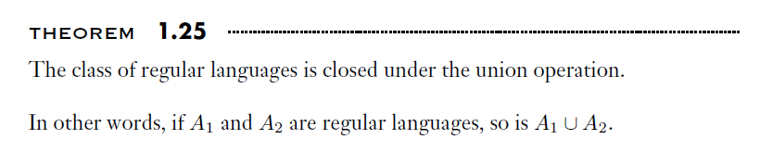
The proof is by construction.
We build a DFA for the union from the individual DFAs.
The idea is simple: While reading the input simultaneously follow both machines.
Put a finger on current state. You need two fingers. You can move these two fingers as per the respective transition function.

Slide 40
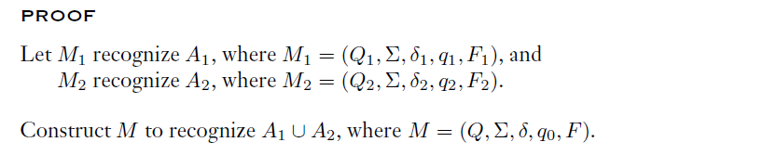
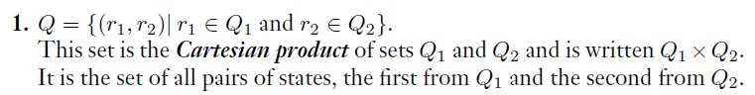
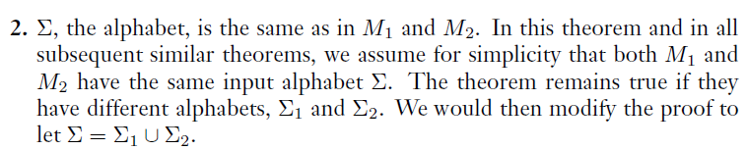

Slide 41
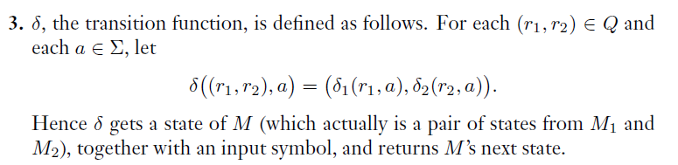
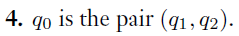
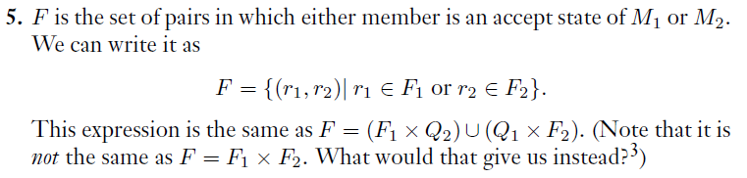

Slide 42
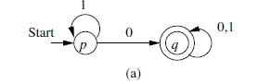
Union Example
What is the language recognized by this DFA?

Slide 43
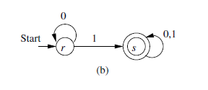
Union Example
What is the language recognized by this DFA?
What is the language recognized by this DFA?

Slide 44
Find DFA for the union

Slide 45
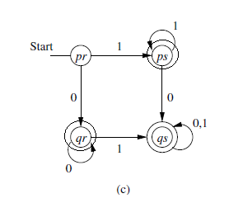
Find DFA for the union

Slide 46
What about intersection?
Intersection of two regular languages is also regular.
Proof: by construction. Similar. Only final states will change.

Slide 47
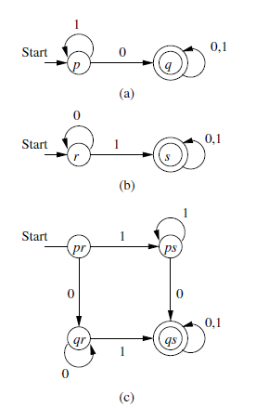
Intersection

Slide 48
What else we can do with product principle?
Set difference.
How?

Slide 49
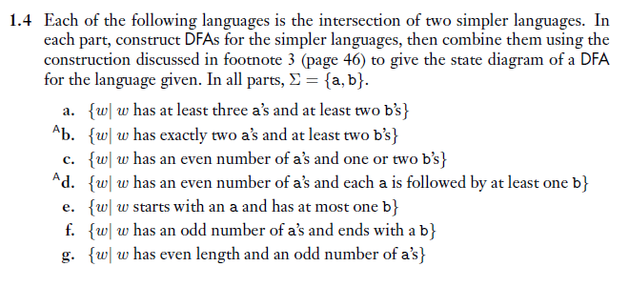

Slide 50
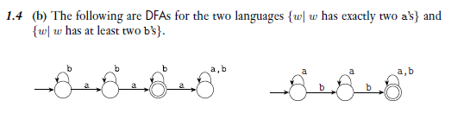
Now find product machine.

Slide 51
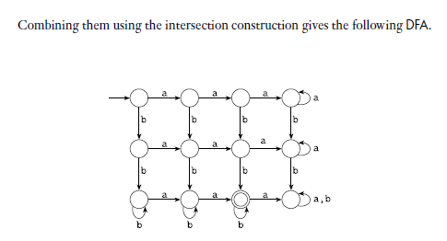
This can be minimized. {Some states are redundant}.

Slide 52
NONDETERMINISM
Useful concept, has great impact on ToC/algorithms.
DFA is deterministic: every step of a computation follows in a unique way from the preceding step.
When the machine is in a given state, and upon reading the next input symbol, we know deterministically what would be the next state.
Only one next state.
No choice !!

Slide 53
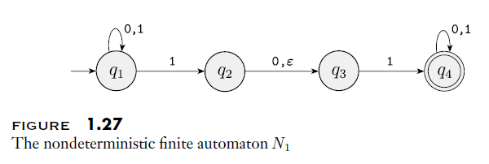
NONDETERMINISM
In a nondeterministic machine, several choices may exist for the next state at any point.
Nondeterminism is a generalization of determinism.

Slide 54
More than one arrow from from q₁ on symbol 1.
No arrow at all from q₃ on 0.
There is Ԑ over an arrow !

Slide 55
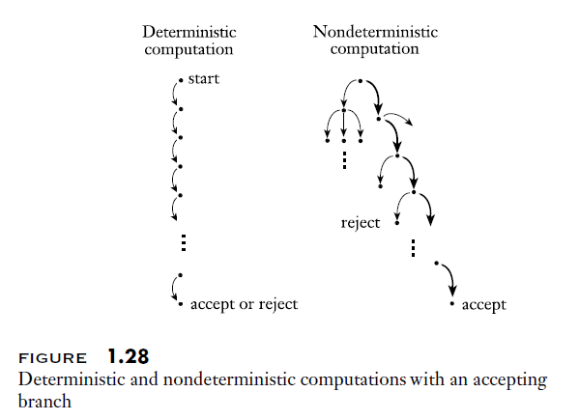
How does an NFA compute?

Slide 56

On input 010110

Slide 57
What is the language accepted by this NFA?

Slide 58
It accepts all strings that contain either 101 or 11 as a substring.
Constructing NFAs is sometimes easier than constructing DFAs.
Later we see that every NFA can be converted into an equivalent DFA.

Slide 59

Building DFA for this is possible, but difficult.
Try this.

Slide 60

But NFA is easy to build.
Notes:
Sipser p51

Slide 61

DFA for A
See number of states and complexity !

Slide 62


Formal definition of NFA

Slide 63

Notes:
p54

Slide 64


Slide 65

Equivalence of NFAs and DFAs
We say two machines are equivalent if they recognize the same language.
Notes:
p54

Slide 66
Proof
Proof by construction.
We build an equivalent DFA for the given NFA

Slide 67

First, for understanding purpose, we assume that there are no edges with Ԑ transitions.

Slide 68




Slide 69

Can you convert the following
What is the language accepted by this?

Slide 70

Now, considering Ԑ arrows
For this purpose, we define Ԑ-CLOSURE of a set of states R.
E(R) is Ԑ-CLOSURE of R.

Slide 71



Slide 72

Example

Slide 73

Now we need to add edges, and
identify the initial state.

Slide 74

Identify the initial state.
Note, it is not {1}

Slide 75

Adding edges, …

Slide 76

After all edges …
But, some states are not reachable !
Simplification can remove this.

Slide 77




Slide 78



Slide 79

Exercise

Slide 80

Exercise
Can you convert each of above NFAs into a corresponding DFA.

Slide 81


Some Notation adapted
This also has all 5 components. This table is complete description of the DFA as the diagram.

